Slide 1
Intelligence & Information

Slide 2
Information vs Intelligence
‘Intelligence is information designed for action’
Lowenthal, M. M. (2009). Intelligence: From secrets to policy (4th edn). Washington DC: CQ Press.
‘All intelligence is information; not all information is intelligence’
Grieve, J. G. D. (2004). Developments in UK criminal intelligence. In J. H. Ratcliffe (ed.), Strategic thinking in criminal intelligence (pp. 25–36). Sydney: The Federation Press.
‘Police information refers to all information obtained, recorded or processed for a policing purpose. It includes information which is processed (known as data, including personal data) and information which has been subject to a process of evaluation (known as intelligence)’
College of Policing APP

Slide 3
Sources of Intelligence
West Yorkshire Police receive and gather intelligence from a wide range of sources including:
Crimestoppers and similar organisations
Police Forces and Law Enforcement Authorities
Organisations with statutory requirements
Covert Policing
Partner Organisations
Police Officers, PCSOs, Police Staff
Information gathered during investigations
Members of the Public
Community intelligence
Technical sources- CCTV, social media, mobile phones

Slide 4
Partners
West Yorkshire Police have partners across a wide range of sectors including:
Education
Health
Local Authority
Housing Providers (Public and Private)
Homelessness Support
Fire and Ambulance Services
Religious Organisations
Support Services for Vulnerable Victims
Offender Services
Political
Charitable Organisations
Security/Crime Prevention
Social Care
Substance Misuse Support
Transport
Utilities
Corporate Businesses

Slide 5
Partnership Intelligence Portal
(PIP)
What is it?
A system which authorised partners and organisations can use to submit information and intelligence to West Yorkshire Police.
What is it not?
A replacement for existing referral or reporting mechanisms
For reporting Crime (101 or 999 in an emergency)
For reporting anything which requires an urgent or critical Police response – ie a crime in action or will be committed imminently

Slide 6
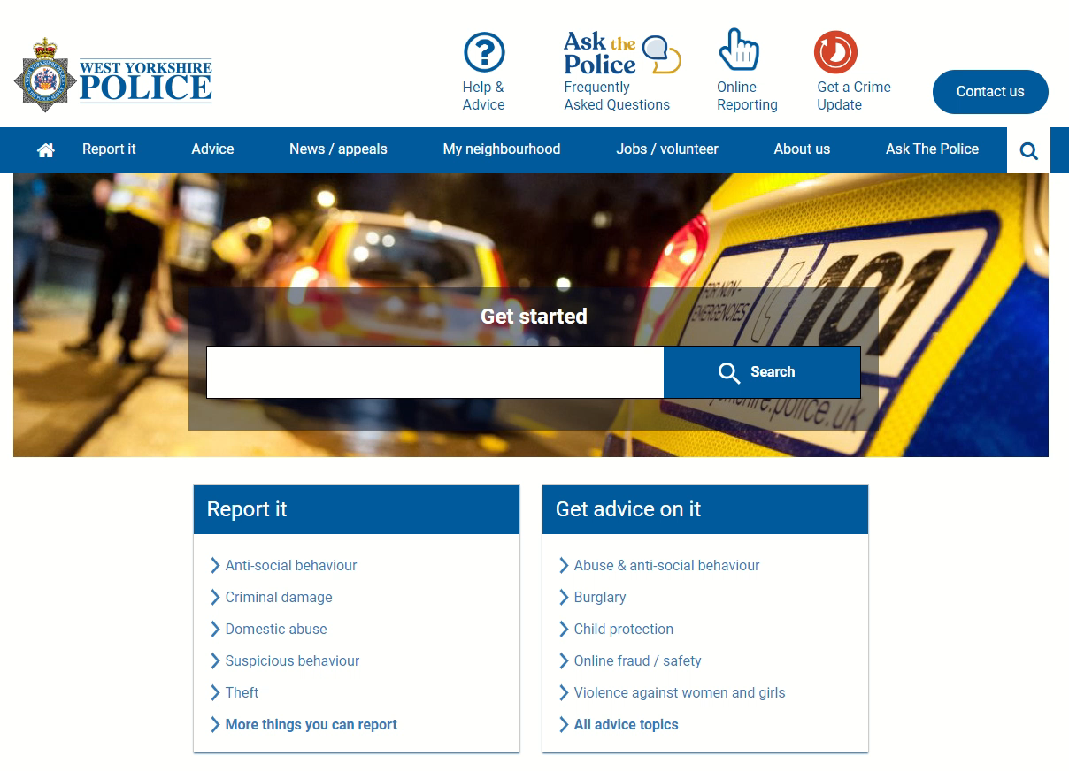
Partnership Intelligence Portal
(PIP)
Accessing the PIP
www.westyorkshire.police.uk
Report It section
Partnership Intelligence Submission
Apply for / Access your account

Slide 7
PIP Flow of Information
Partner
PIP sends you a copy
District Intelligence
Action needed?
Partnership Intelligence Portal
Complete & submit
Specialist team
Delivers to WYP
Risk assessed
URN sent to you

Slide 8
Intelligence Collection & Interventions
How is the intelligence used?
Police have both specific and generic intelligence collection plans to support proactive interventions which can prevent, disrupt, and detect criminality as well as safeguarding actual and potential victims.

Slide 9
Examples from PIP
Key intelligence about an organised crime gang from West Yorkshire operating across the country.
A business premise which had signs of modern slavery & human trafficking.
Members of the public passing information to a partner regarding possible locations, victims and perpetrators of CSE.
Information about knife crime and gang involvement following stabbings at high schools.

Slide 10
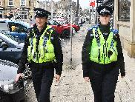
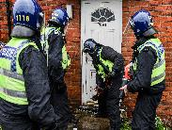
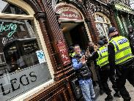
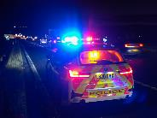
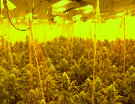
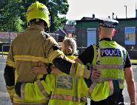
Intelligence Collection & Interventions
Examples of interventions:
Safeguarding visits/debriefs – eg timed using intelligence that indicates when a perpetrator will be absent
Search warrants obtained and executed
Arrests
Intelligence led vehicle stops
Visible presence and targeted patrols
Joint visits with agencies eg Probation, Housing, HMRC, Immigration, Local Authorities, WYFRS, Licencing
Civil Orders & Injunctions

Slide 11
Evaluation & Sanitisation
Paralleling Information
Some intelligence can only have been provided by a limited number of people.
This could be an exact location of a weapon or storage place, or information which is known only to a person close to an offender such as family and using the intelligence may identify who provided it to the Police.
In these situations, Police will seek to ‘parallel’ the information by obtaining it from other available sources or conduct further enquiries that may provide the same or similar information.
By ‘paralleling’ the intelligence, Police protect the source of the information. Where it is not possible to negate the risk, Police may choose not to use such intelligence at all or until further corroboration is received.

Slide 12

Intelligence Requirements
Child Sexual Exploitation CSE
Signs to look for (non-exhaustive):
Use of drugs and alcohol
Unhealthy or inappropriate sexual behaviour
Changes in mood or character
Emergency contraception
Unexplained money / items
Signs of physical abuse- injuries in genital area
Involvement in criminal activity- shop lifting, drugs supply
Mental health problems
Suicide attempts
Young pregnancy
Same males with difference young people (taxis/hotels etc)

Slide 13






Intelligence Requirements
Child Sexual Exploitation CSE
Who? Victims, perpetrators, facilitators. What are the vulnerabilities?
Where? Vulnerable locations, places used, use of hotels etc, locations of exploitation or grooming.
Phone numbers, social media accounts, platforms used. How is contact initiated? Online/in person contact?
Travel- vehicles (including registration numbers), taxis, public transport. How are victims transported? Do offenders compel them?
How does the exploitation take place? Are substances used?
What are the trends?

Slide 14
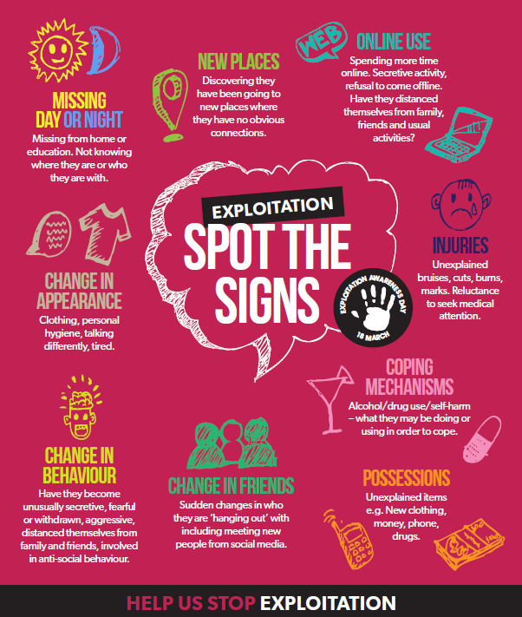
Intelligence Requirements
Child Criminal Exploitation CCE
Signs to look for (non-exhaustive):
Frequently absent from school-
poor performance
Missing episodes, staying out late
Unexplained travel
Anger and violence issues
Unexplained money and new/expensive items
Use of ‘new’ slang
Increase of phone use
Secretive
Carrying weapons
Self-harm / poor emotional state
New adult/older ‘friends’
Use of drugs/alcohol
Unexplained injuries
Committing ‘petty’ crime such as vandalism, shoplifting
Involvement in ASB
Collected/dropped off by unknown vehicles

Slide 15
Intelligence Requirements
Child Criminal Exploitation CCE
Signs to look for (non-exhaustive):
Carrying weapons
Self-harm / poor emotional state
New adult/older ‘friends’
Use of drugs/alcohol
Unexplained injuries
Committing ‘petty’ crime such as vandalism,
shoplifting
Involvement in ASB
Collected/dropped off by unknown vehicles

Slide 16
Intelligence Requirements
Child Criminal Exploitation CCE
Who? Victims, Perpetrators. How are they recruited? What are the victims’ vulnerabilities? What enticements are offered?
Where? ASB hotspots, offence locations
Phone numbers, social media accounts, platforms used. Offending directed by phone?
Travel- vehicles (including registration numbers), taxis, public transport. How are victims transported?
What crime types? Who benefits? Links to lifestyle? Substance misuse? Links to county drug lines?

Slide 17

Intelligence Requirements
Modern Slavery &
Human Trafficking MSHT
Signs to look for (non-exhaustive):
Movements controlled/monitored
Documents withheld
Unfamiliar with area in which they work
Little interaction with others
Relationships don’t seem right eg inappropriate age
Living in dirty, cramped or overcrowded
accommodation, and/or living and working at the
same address
Have few personal possessions and wear the same
clothes day in and day out.
Unsuitable clothing for their work- no PPE for the job
Access to money is restricted
Signs of physical or psychological abuse
Untreated injuries/lack of medical attention
Appear malnourished or unkempt- poor hygiene
Anxious/agitated or appear withdrawn and neglected
Dropped off / collected for work on a regular basis very early or very late- long working hours
Unusual travel arrangements
Avoiding eye contact- appear frightened or hesitant to talk to strangers
Unwilling to take payment
Cash heavy businesses

Slide 18
Intelligence Requirements
Modern Slavery &
Human Trafficking MSHT
Signs to look for (non-exhaustive):
Signs of physical or psychological abuse
Untreated injuries/lack of medical attention
Appear malnourished or unkempt- poor hygiene
Anxious/agitated or appear withdrawn and neglected
Dropped off / collected for work on a regular basis
very early or very late- long working hours
Unusual travel arrangements
Avoiding eye contact- appear frightened or hesitant
to talk to strangers
Unwilling to take payment
Cash heavy businesses
Movements controlled/monitored
Documents withheld
Unfamiliar with area in which they work
Little interaction with others
Relationships don’t seem right eg inappropriate age
Living in dirty, cramped or overcrowded accommodation, and/or living and working at the same address
Have few personal possessions and wear the same clothes day in and day out.
Unsuitable clothing for their work- no PPE for the job
Access to money is restricted

Slide 19
Intelligence Requirements
Modern Slavery &
Human Trafficking MSHT
Who? Victims, Perpetrators, Facilitators. How are victims recruited? What are their vulnerabilities? What is the hierarchy. Victims’ shared characteristics?
Where? Pickup locations, exploitation locations and businesses. Where do victims live? Landlords/businesses complicit?
Phone numbers, social media accounts, platforms used. Online recruitment?
Travel- vehicles (including registration numbers), taxis, public transport. How are victims transported? Repeat journeys?
What crime types are prevalent?
Linked to Immigration crime?

Slide 20

Intelligence Requirements
Serious & Organised Crime SOC
What is Serious & Organised Crime?
Programme Precision Strategy states that for criminal activity to be defined as “Serious and Organised Crime” the following criteria must be met:
More than one criminal is involved;
It involves control, planning and use of specialist resources;
It causes significant harm or has the potential to do so;
There is material gain, which is usually financial
The most common types of serious and organised crime are:
Drugs- including County Lines
Firearms
Human trafficking and organised immigration crime
Organised Exploitation of Vulnerable People (OEVP)
Fraud and economic crime including the rising threat from cyber related crime
Corruption within law enforcement organisations and professional bodies
Organised acquisitive crime including burglary and robbery
Serious crime is defined in section 93(4) of the Police Act 1997 as:
‘Conduct which:
involves the use of violence, results in substantial financial gain or is conducted by a large number of persons in pursuit of a common purpose, or
the offence or one of the offences is an offence for which a person who has attained the age of twenty-one and has no previous convictions could reasonably be expected to be sentenced to imprisonment for a term of three years or more.'

Slide 21
Intelligence Requirements
Serious & Organised Crime SOC
What is Serious & Organised Crime?
Corruption within law enforcement organisations and professional bodies
Firearms
Human trafficking and organised immigration crime
Organised Exploitation of Vulnerable People (OEVP)
Fraud and economic crime &
the rising threat from cyber related crime
Drugs- including County Lines
Organised acquisitive crime including burglary and robbery

Slide 22
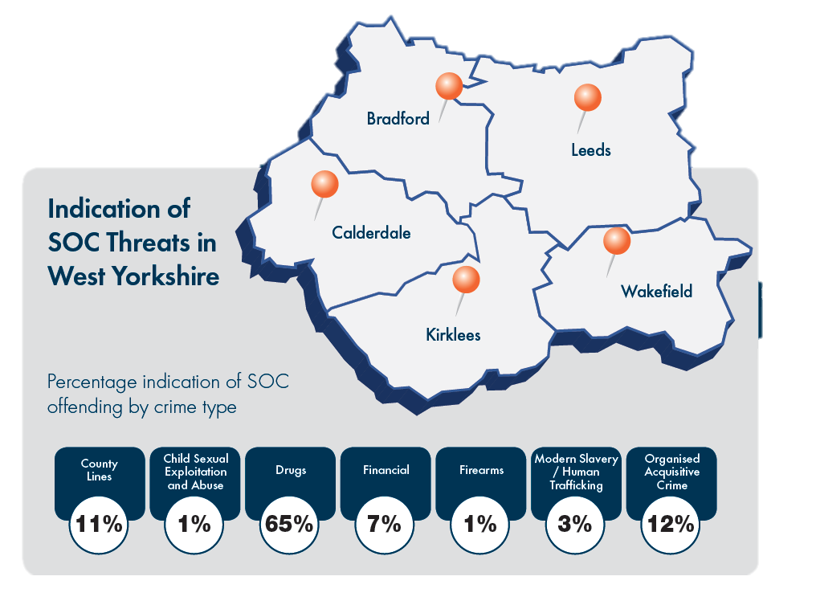
Intelligence Requirements
Serious & Organised Crime SOC
What is Serious & Organised Crime?

Slide 23
Intelligence Requirements
Serious & Organised Crime SOC
Who? Offenders, facilitators. What is the hierarchy? Involvement in CCE and County Lines? How are victims identified?
Where? What areas are most affected? Where are county lines operating? Storage locations
Phone numbers, social media accounts, etc used by offenders. County line numbers
Travel- vehicles (including registration numbers), taxis, public transport. How are victims transported? How are drugs/firearms transported?
What crime types are prevalent? Links to OIC and MSHT? Developing trends- e.g. new drug and effects. What vulnerabilities are exploited? How are criminal proceeds laundered/managed? Access to firearms and weapons?

Slide 24
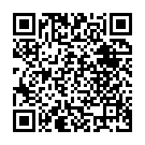
Intelligence Requirements
No matter how insignificant or trivial information may seem, it may provide the missing piece of the puzzle and could be key in helping to safeguard victims and prevent crime, as well prosecuting offenders to keep our communities safe.
West Yorkshire Police have a wealth of posters and other literature available on current campaigns as well as information on the Force website at https://www.westyorkshire.police.uk/
QR Code for PIP:

