Slide 1


Wakefield MARAC
Awareness Training

Slide 2
What we will cover
Prevalence of Domestic Abuse
Domestic Abuse Act and Definition of Domestic Abuse
What is MARAC and its aims
The MARAC Process
Caution regarding perpetrators
Repeats and Transfers
Local MARAC statistics

Slide 3
Prevalence of Domestic Abuse
There are some 2.4 million victims of domestic abuse a year aged 16 to 74 (two-thirds of whom are women) and more than one in ten of all offences recorded by the police are domestic abuse related (ONS)
In UK, 1 in 4 women and 1 in 6 men will experience domestic abuse at some point in their lives (ONS)

Slide 4
The Children’s Commissioner estimates that 3 million children under the age of 17 live in a domestic abuse household and 1 in 5 children see or hear the abuse
On average victims at high risk of serious harm or murder live with domestic abuse for 2-3 years before getting help (SafeLives)

Slide 5
A key change from the Domestic Abuse Act 2021
There is now a new statutory definition of domestic abuse, emphasising that domestic abuse is not just about physical abuse….

Slide 6
Definition of
Domestic Abuse
Behaviour of a person (A) towards another person (B) is domestic abuse if –
A and B are each aged 16 or over and are personally connected to each other, and the behaviour is abusive

Slide 7
What do we mean by ‘personally connected’?
They are, or have been, married to each other
They are, or have been, civil partners of each other
They have agreed to marry one another (whether or not the agreement has been terminated)
They have entered into a civil partnership agreement (whether or not the agreement has been terminated)

Slide 8
They are, or have been, in an intimate personal relationship with each other
They each have, or there has been a time when they each have had, a parental relationship in relation to the same child
They are relatives
‘Child’ means a person under the age of 18 years

Slide 9
Children…
Any reference in this Act to a victim of domestic abuse includes a reference to a child who –
sees or hears, or experiences the effects of the abuse, and
is related to A or B

Slide 10
Types of abuse…
Physical abuse
Sexual abuse
Controlling or Coercive behaviour
Economic abuse
Psychological, Emotional abuse
Honour based abuse, forced marriage, Female Genital Mutilation
The behaviour can be a single incident or ongoing

Slide 11
What is MARAC?
Multi Agency Risk Assessment Conference
MARAC is a meeting where agencies from the Wakefield District meet on a 2 weekly basis, covering 25-30 cases per meeting, to share information about high risk domestic abuse victims
Mixture of new cases, repeats and transfers
Focuses on adult victims and their families

Slide 12
A risk focussed, coordinated safety plan is drawn up to help support the victim and try to reduce the risk to them and any children
MARAC recognises that no single agency or individual can see the complete picture of the life of a victim, but all may have insights that are crucial to their safety

Slide 13
The victim does not attend the meeting but is represented by WDDAS who bring the victim’s thoughts, wishes and feelings to the meeting
DRAM (Daily Risk Assessment Meeting) hears high risk cases to discuss and evaluate immediate threat to victims and family

Slide 14
Aims of MARAC
To share information, to increase the safety, health and well being of victims and their children
To construct jointly and implement a risk management action plan that provides professional support to all those at risk and to reduce the risk of harm
To reduce repeat victimisation
To reduce offending by perpetrators

Slide 15
To improve agency accountability
To identify those situations that indicate a need for the Local Safeguarding Children Board’s Child Protection procedures to be initiated
To improve support for victims involved in high-risk domestic abuse cases

Slide 16
Agencies/Organisations involved in MARAC (ad hoc invites)
Wakefield
MARAC
Wakefield
MARAC
Police
WDDAS
CYPS
Adult Safeguarding
Housing Needs Service
WDH
SWYPFT
(Mental Health)
Victim Support
Education Welfare
Probation
Inspiring Recovery
0-19yrs
Child Health
NHS
Youth Offending Team
Family Hubs
IOM (Integrated Offender Mngmt)

Slide 17


Slide 18
What is DASH?
Domestic Abuse, Stalking, Harassment and Honour Based Abuse
Risk Assessment tool to establish risk to the victim
Used by practitioners who work with victims of domestic abuse when they receive an initial disclosure of domestic abuse

Slide 19
Wakefield MARAC Criteria
Visible High Risk:
The number of ‘ticks’ on DASH (Domestic Abuse, Stalking, Harassment and ‘Honour'-based violence risk checklist) - If you have ticked 14 or more ‘yes’ boxes the case would meet the MARAC referral criteria, regardless of consent

Slide 20
Automatic Trigger to MARAC
Non fatal strangulation
Stalking/harassment
Rape
Sexual assault
Choking
Drowning
Credible threats to kill
Even if tick less than 14 on DASH

Slide 21
Professional Judgement:
Serious concerns about a victim’s situation - refer to MARAC
Based on your experience and/or the victim’s perception of their risk

Slide 22
Potential Escalation:
Number of police callouts to the victim as a result of domestic abuse in the past 12 months
Made by police when a person has been the clear victim of 6 incidents graded at medium risk

Slide 23
If the victim does not meet the criteria to refer to MARAC, practitioners should signpost the victim to WDDAS and other relevant support services

Slide 24
It is important to be mindful of Honour Based Abuse, LGBTQIA+ and conversion therapy, cultures, sexuality, traveller community, human trafficking and modern day slavery
We think numbers are small but are they? Professional curiosity
If unsure, send referral in anyway

Slide 25
How to Refer
Complete the following:
DASH (from SafeLives or contact MARAC Coordinator)
MARAC Referral Form
The referral forms and DASH (not handwritten please) should be sent to each agency’s MARAC representative, then they send by email to the MARAC Coordinators and Wakefield District Domestic Abuse Service (WDDAS)

Slide 26
MARAC Procedure Flowchart
Step-by-Step Guide for Referring into MARAC

Slide 27
Step 1
Practitioner receives an initial disclosure of Domestic Abuse
Complete a DASH Risk Assessment with the victim. Using the DASH and your own judgement to establish whether the case is Standard/Medium/High Risk

Slide 28
Step 2
Standard – Own agency intervention with referrals to other agencies where appropriate.
Medium – Consider if this is the 6th or more medium risk incident in the past 12 months – if yes, refer to MARAC. If no, refer into other agencies where appropriate.
High – Refer to MARAC (high risk DASH/incidents negates consent and is to be referred to MARAC regardless of Victim’s consent).
The referring agency will complete a MARAC referral form, WDDAS referral form and attach the completed DASH. These documents need to be sent by email to wakefield.marac@westyorkshire.police.uk (MARAC) and domesticabuse@wakefield.gov.uk (WDDAS)

Slide 29
Step 3
1. MARAC Co-Ordinator(s) will complete police research, add the case to the next available MARAC meeting and send details of the referral to the MARAC agency representatives.
3. MARAC discussion held, information shared and actions are agreed to reduce the risks. This is all recorded in a confidential manner and the action matrix is circulated to partners.
2. Agenda is then circulated by secure email to MARAC agency representatives who attend MARAC.
5. Victim is updated on MARAC by IDVA or another supporting agency where necessary.
4. Designated agency representatives are to ‘flag and tag’ the discussed nominals on their respective systems for 12 months.

Slide 30
Step 4
Repeat incidents that occur within the 12-month MARAC period are to be notified to other agencies and MARAC by email (regardless of whether it has been reported to the police). A further notifiable incident includes any violence, threats of violence, a pattern of stalking and harassment, rape or sexual abuse and non-fatal strangulation.
Repeat High Risk incidents are placed into the next available MARAC meeting for a further discussion. The normal MARAC procedure is then followed.
After 12 months, (with no repeated incident between same victim/perpetrator), the MARAC coordinator will close respective MARAC occurrences and de-flag and de-tag their systems.

Slide 31
Agencies should not wait until a case has been discussed at MARAC before taking any action or giving advice and signposting them to services if necessary
Referral Process Flowchart

Slide 32
The following logs are completed at point of referral and sent out prior to the meeting to complete and return by partners

Slide 33
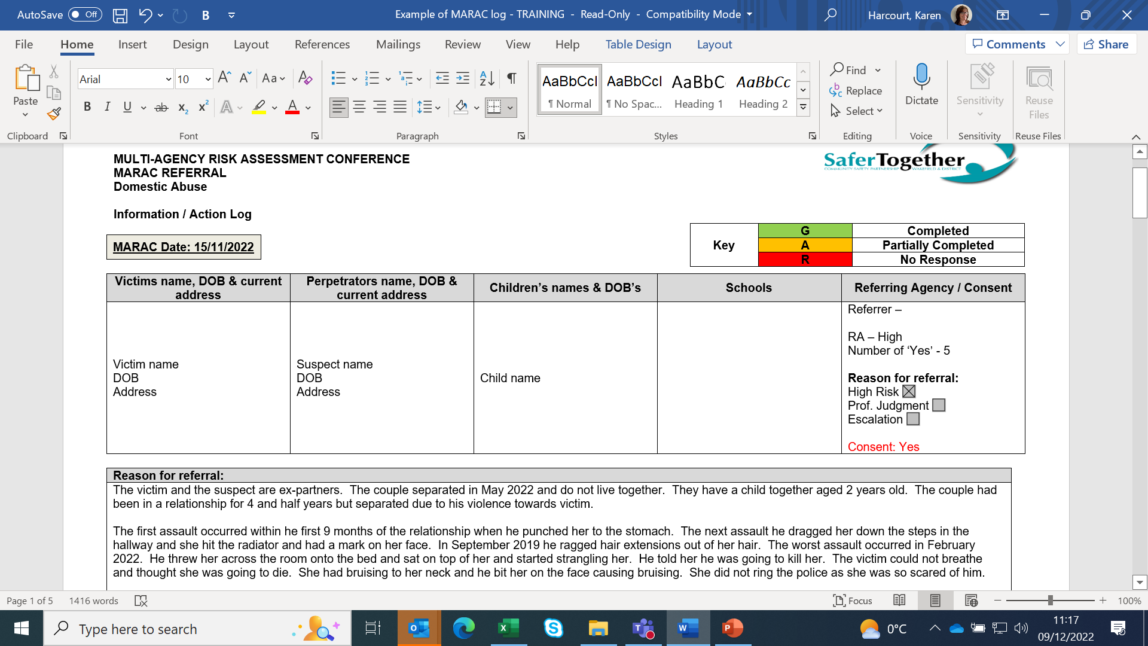

Slide 34
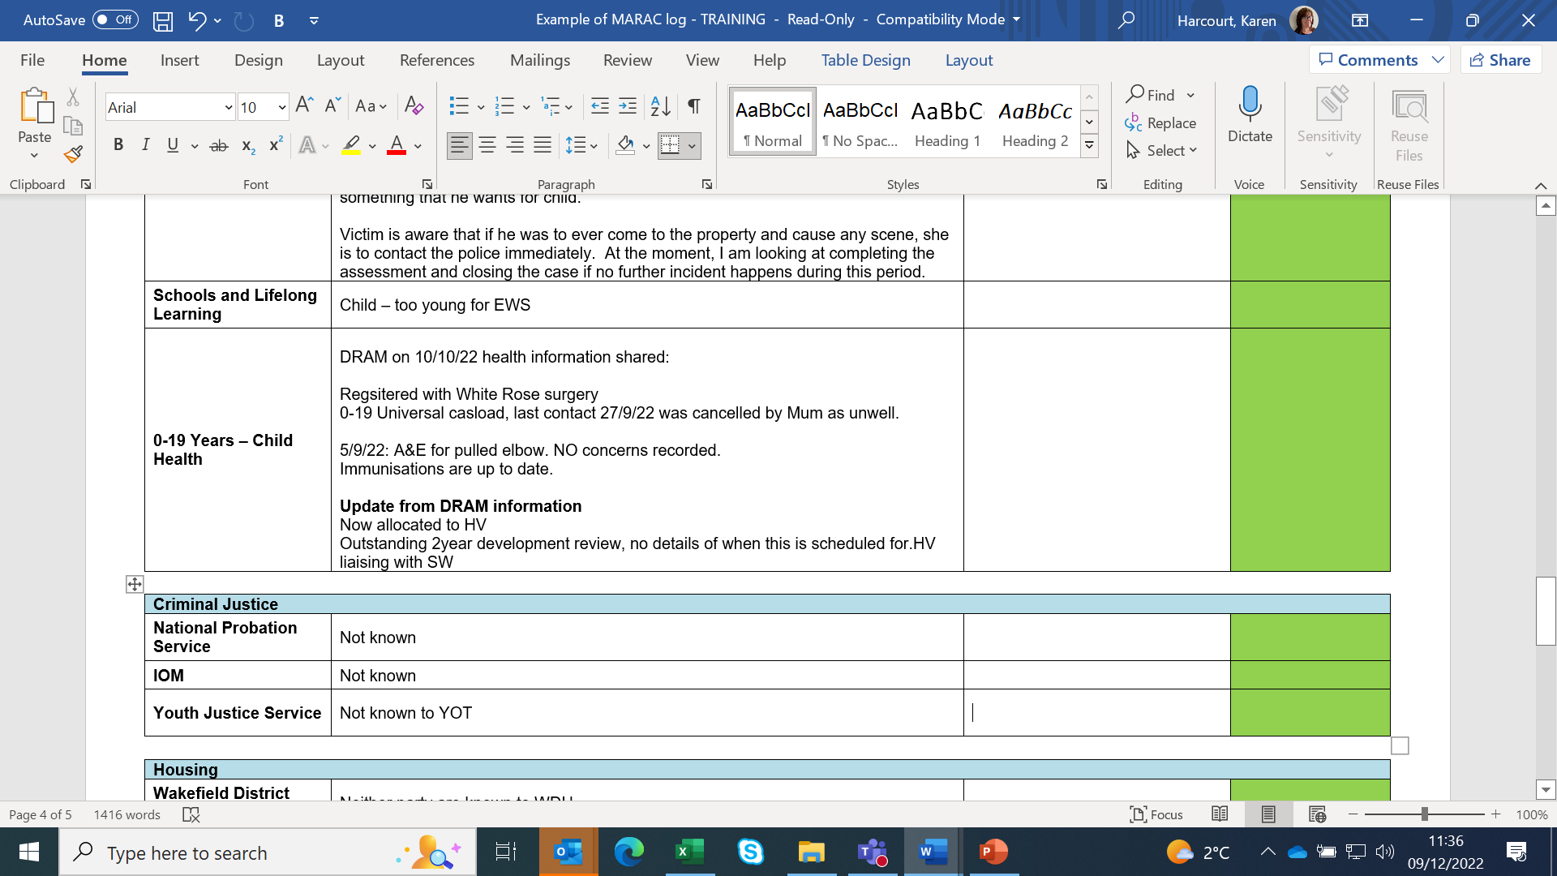

Slide 35
The Meeting
10 minutes per case
Only updated or new information not on the log is shared
Any new actions are then put on Action Matrix, which is emailed to partners within 2 days of the meeting for actions to be completed

Slide 36
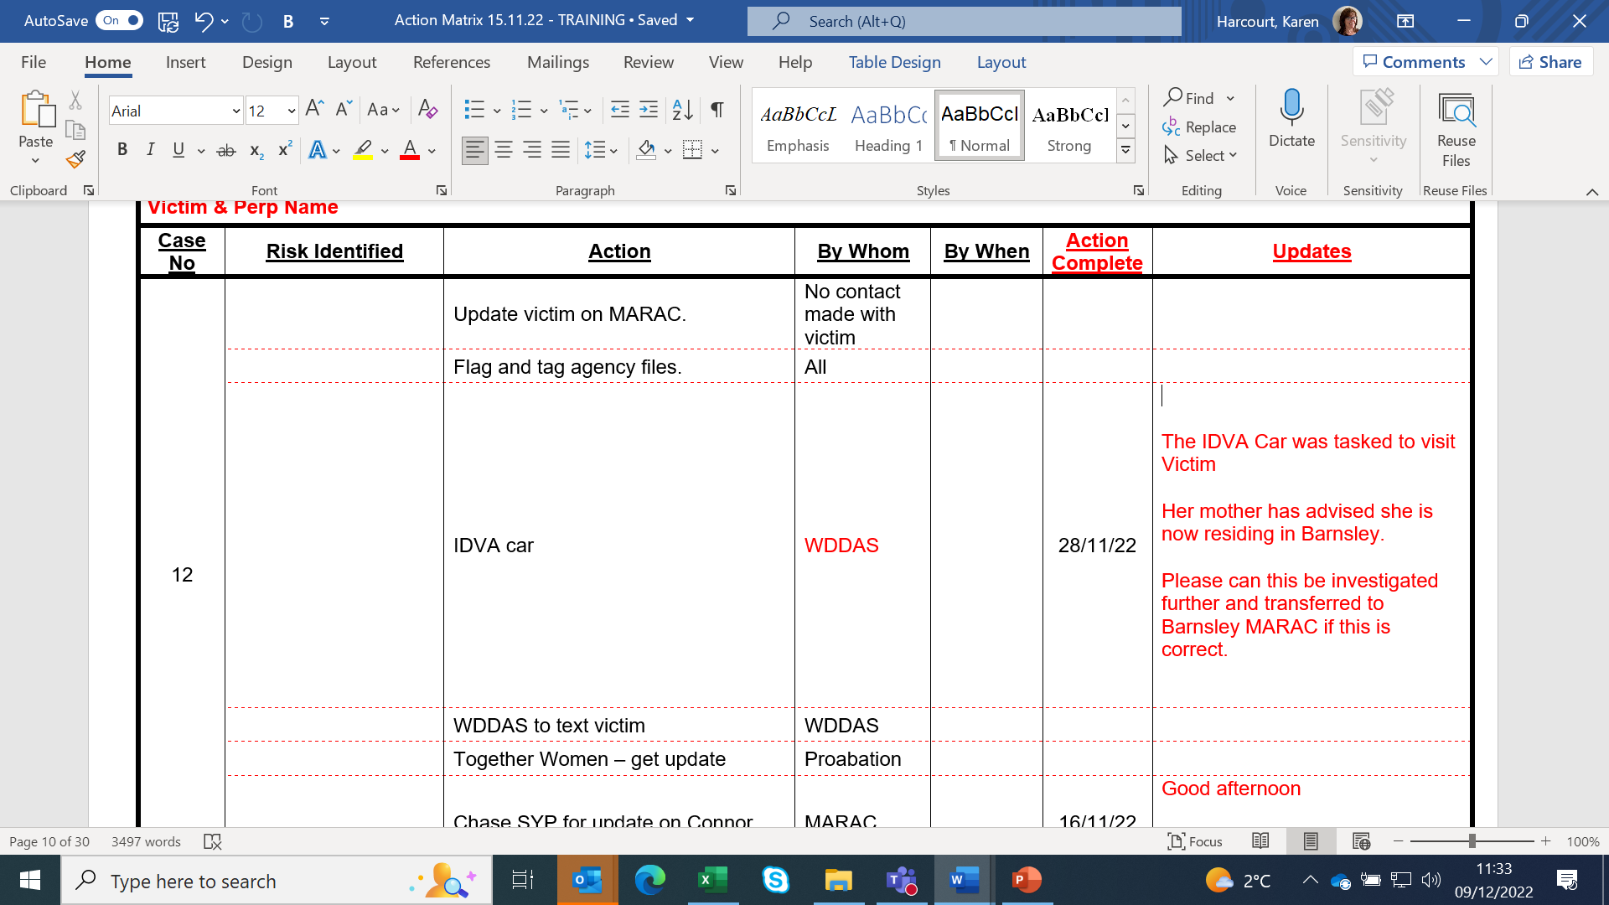

Slide 37
Actions
Partners update the MARAC Coordinator of their actions (even if they cannot do them)
e.g. ‘Contacted police officer to update’,
‘WDDAS to visit victim jointly with Social Worker’
Steering Group, where incomplete actions are scrutinised, started again in November 2022 – held quarterly

Slide 38
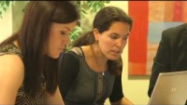

Slide 39
Confidentiality
MARAC information is strictly confidential and the chair will read out the confidentiality agreement at the start of each meeting
In line with the signed MARAC Information Sharing Agreement, DO NOT save MARAC information onto your agency files

Slide 40
Discussion should not be shared with any other person, including the victim and perpetrator, without the express permission of the Chair as any disclosure may result in greater risk to the victim

Slide 41
MARAC information MUST NOT be photocopied, copied & pasted into any document or disclosed to anyone or any other agency, without the prior consent of the MARAC Chair

Slide 42
MARAC Minutes
Strictly confidential - nature of discussions and information shared and action plan put in place
Recorded via teams/audio - provided upon request
All reminded at start of meeting - responsibility to make notes and feedback any information shared which they think needs to be shared with front line staff

Slide 43
If minutes are needed for family court proceedings, then a court order from a judge is required. If the minutes are disclosed then they will be for the judge’s eyes only in order for them to make a decision about the case

Slide 44
MARAC and the perpetrator
A MARAC Perpetrator MUST NEVER know they have been discussed at a MARAC and the meeting MUST NEVER be discussed with them
MARAC MUST NOT be disclosed in court or any conferences / meetings

Slide 45
Repeat Incidents
A repeat MARAC case is when a further high-risk incident is identified within 12 months of the initial referral. Includes any one of the following types of behaviour, which, if reported to the police, would constitute criminal behaviour:
Violence or threats of violence to the victim (including threats against property)
A pattern of stalking or harassment
Rape or sexual abuse
Non fatal strangulation

Slide 46
Any agency may identify this further incident (regardless of whether it has been reported to the police)
Where a repeat victim is identified by any MARAC agency, that agency should refer the case back to MARAC by notifying the MARAC Coordinator. If you have further concerns for a victim of a MARAC case but there has not been a specific incident, the MARAC Coordinator should be contacted to discuss this

Slide 47
Repeat Incidents: Roles
Victim – Jane Bloggs
Suspect – Joe Bloggs
Referred to MARAC and discussed on 01/06/22
01/07/22 – further assault has occurrence – Victim is Jane / Suspect is Joe
THIS WOULD BE A MARAC REPEAT

Slide 48
Victim – Jane Bloggs
Suspect – Joe Bloggs
Referred to MARAC and discussed on 01/06/22
01/07/22 – further assault – Victim is Joe / Suspect is Jane
THIS IS NOT A MARAC REPEAT
If incident on 01/07/22 is graded high risk, need to decide who the victim is. If Joe is deemed to be the victim needs a new referral

Slide 49
Transfers
The MARAC where the victim lives is responsible for the case
If you are working with a MARAC victim and receive notification they have moved outside the Wakefield area (either temporary or permanent) the MARAC Coordinator needs to be made aware. A “transfer out” can then be done to the new area

Slide 50
If you are working with a family who have moved into the Wakefield area and the victim notifies you, or you believe they have been discussed at MARAC in another area, the MARAC Coordinator needs to be made aware to facilitate a “transfer in”
Once the paperwork has been received the case will be put on the next agenda and discussed
‘Transfer in’ cases are sent to MARAC Coordinators

Slide 51
MARAC Occurrence on Niche
Each occurrence remains open for a rolling 12 months from the date the case has been discussed at MARAC. Once the 12 months has ended, the MARAC Coordinator will finalise the occurrence if there have been no further high risk incidents or 6 incidents graded as medium in the past 12 months

Slide 52
Wakefield MARAC statistics year ending March 2022
MARAC cases (SafeLives)
Area Name | Number of MARACs | Number of cases discussed | Number of repeat cases | Number of children in household
Yorkshire and Humber | 18 | 14,207 | 5375 | 18,142
Humberside | 4 | 3291 | 1538 | 3176
North Yorkshire | 5 | 1871 | 790 | 3077
South Yorkshire | 4 | 3552 | 1179 | 4121
West Yorkshire | 5 | 5493 | 1868 | 7768

Slide 53
Source of Wakefield Referrals
Police 79.4%
Secondary Care/Acute Trust 4.2%
IDVAs 4%
Housing 1.6%
Primary Care Services 1.4%
Voluntary Sector 1.4%
Probation 1%

Slide 54
Adult Social Care 0.7%
Children Social Care 0.6%
Substance Abuse Services 0.5%
Mental Health Services 0.4%
Multi-Agency Safeguarding 0.4%
Education 0.2%
Other 4.2%

Slide 55
Wakefield Referrals
Gender
90.9% Female
9.1% Male
Demographics
Black Asian and racially minoritized 17.4%
Victims with disability 6.6%
LGBTQIA+ victims 1.3%

Slide 56
Sources of Support
Wakefield District Domestic Abuse Service 0800 915 1561
West Yorkshire Police website www.westyorkshire.police.uk
SafeLives
Resources for Marac meetings | Safelives

Slide 57
Please get in touch …
MARAC Coordinator
wakefield.marac@westyorkshire.police.uk
01924 878361/878389

